Slide 1
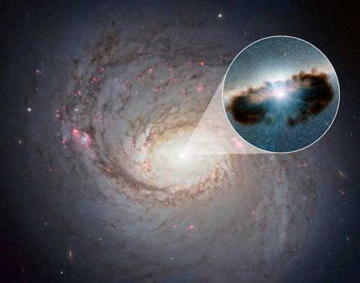
The mass of monsters
Supermassive black holes at the early universe
Julián
Mejía-Restrepo

Slide 2


Slide 3
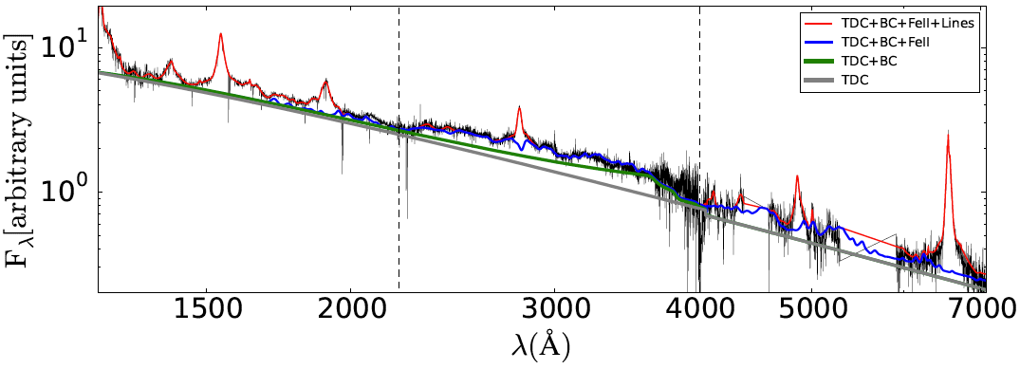
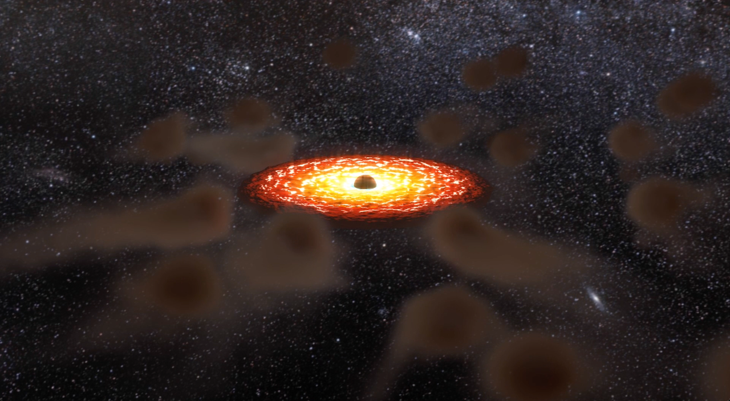
While supermassive black hole masses are well determined
local and mid distance (age)
Universe. Mass estimations at very large
distances (early universe) are very unreliable
CIV z>2.0
MgII
Hβ
z<0.8
Hα
z<0.4
Universe’s
Childhood
Universe’s
Teen age
Good
masses
Wrong
masses
Credits: Ricardo Ramírez

Slide 4
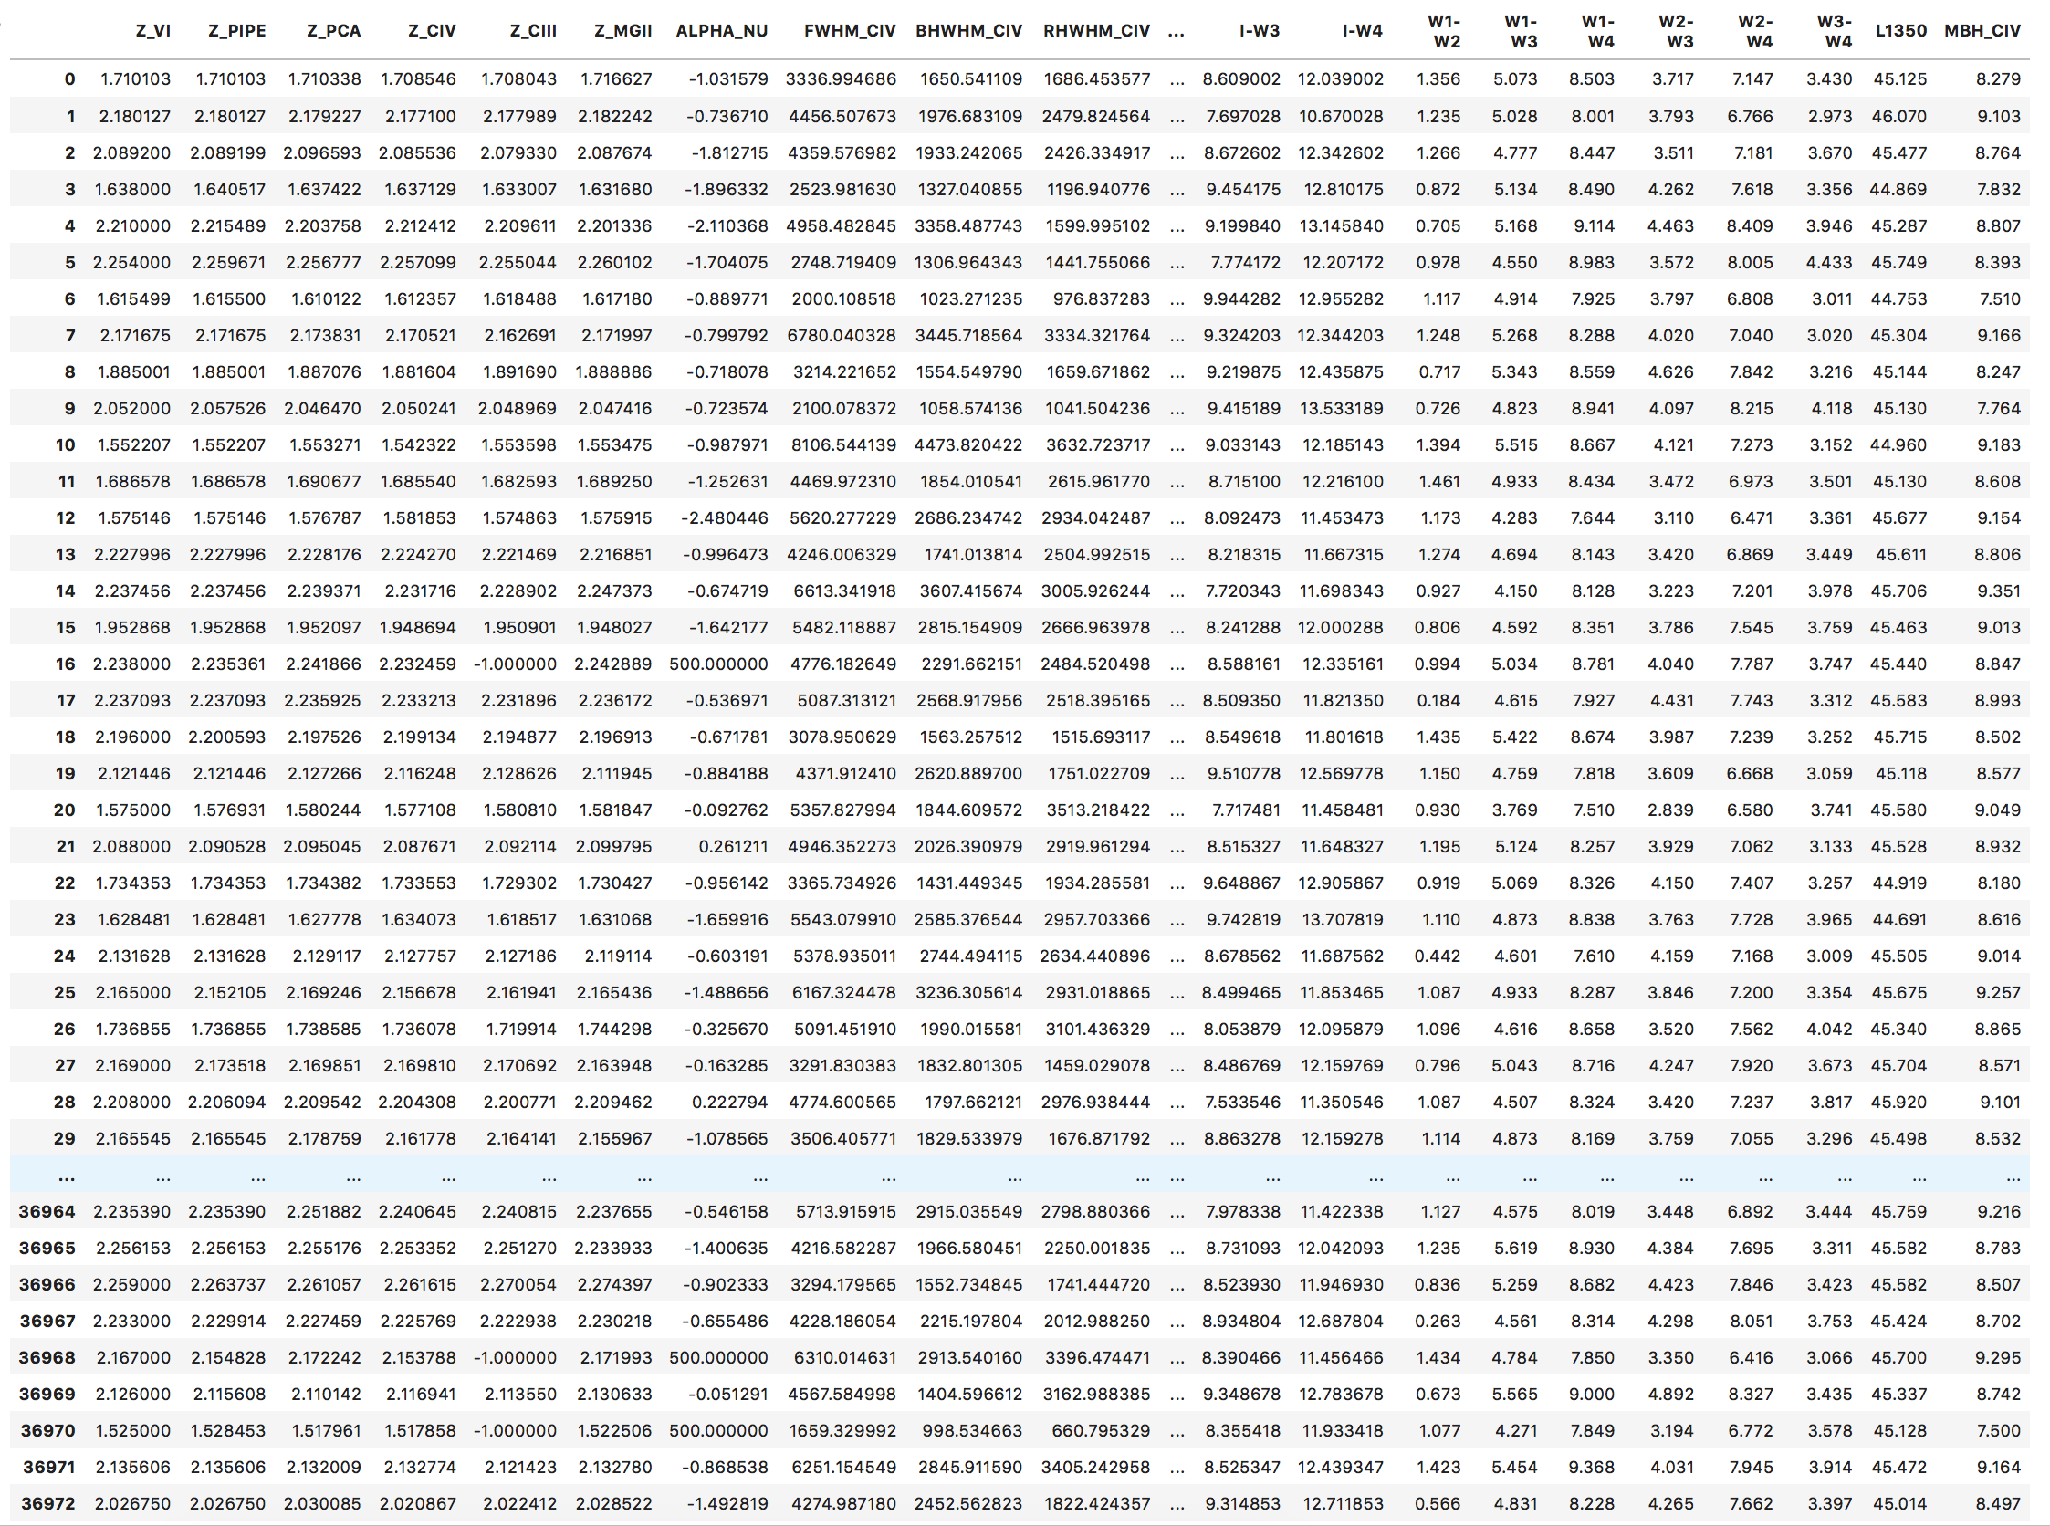
Objective: Improve current black masses from the early universe using collected
data from a public large database: SLOAN DIGITAL SKY SURVEY
~40.000 datos y 106 features

